Slide 1





ADAPTIVE
INFOTECH
Fundamentals Of
EMBEDDED SYSTEMS
Certification Course
From Microchips to Mastery – Learn Embedded Systems Today!
www.adaptit.co.in +91-9840786878

Slide 2

ABOUT US
Starting as a small team with big dreams, Adaptive InfoTech tackled challenges with passion, delivering top-notch solutions. With multiple successful projects, we've proven that adaptability, innovation, and dedication drive success. From a startup to an industry force, we continue to push boundaries and build the future with our comprehensive software and hardware solutions that transform businesses. Our team of experts combines technical expertise with business acumen to deliver solutions that not only work flawlessly but also drive real business results.
Our Virtual courses/Onsite practical provide a gateway to knowledge, allowing learners to access high-quality education from anywhere in the world.

Slide 3




VISION AND MISSION
Our Vision
To be a globally recognized leader in empowering individuals and businesses through innovative software and hardware solutions and transformative learning experiences.
Our Mission
We are dedicated to building robust and scalable software and hardware solutions and democratizing technology education through engaging and effective training programs and online resources.

Slide 4



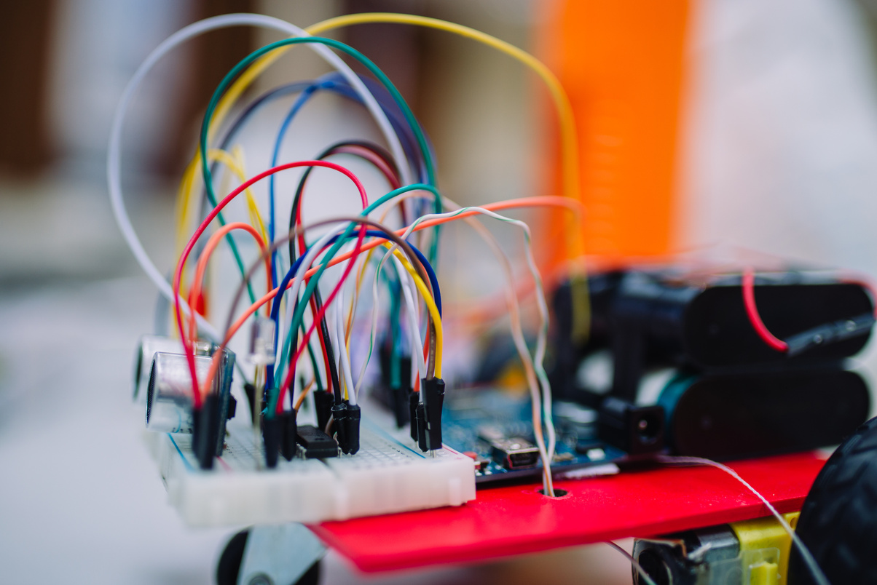


EMBEDDED SYSTEM COURSE OFFERINGS
Our Fundamentals Of Embedded Systems Course offers the perfect mix of theory and hands-on learning. Learn microcontrollers, sensors, real-time systems, and IoT through live projects. Get certified and gain the skills to build real-world tech solutions.
Hands-on Training with real hardware
Industry-Recognized Certification
Project-Based
Learning
Real-Time Applications
Internship Opportunity

Slide 5





KEY FEATURES
OF OUR COURSES
Hands-on Projects
Concept to Application
Learn by building real-world embedded systems.
Strong foundation in microcontrollers, sensors, IoT, and real-time systems.
Embedded systems are small, task-specific computers built into larger systems. They work in real-time, use low power, and are highly reliable. Key features include compact size, efficiency, and connectivity.
Live Interactive Sessions
Career-Focused Training
  Engaging classes with expert instructors.
  Skills aligned with job roles in IoT, automation, and robotics.

Slide 6


COURSE OVERVIEW
Introduction to Embedded Systems
Microcontrollers and Microprocessors
Embedded C Programming
Printed Circuit Board Design
Real-Time Operating Systems (RTOS)
System Development and Debugging
Embedded System Applications
Mini Project

Slide 7



PROGRAM DETAILS
Course Starts:
Duration:
Starting on JULY First Week.
Hands-on Embedded Skills in Just 12 Weeks!
Capstone Project:
Certificate:
Hands-on case studies with
practical implementations.
Certificate will be provided on course completion.
Fee Structure:
Virtual Course:
Onsite Practical:
2,999/-
2,999/-

Slide 8
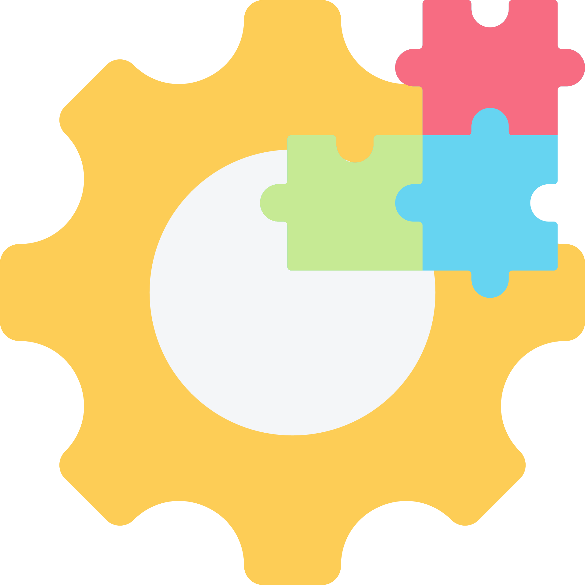
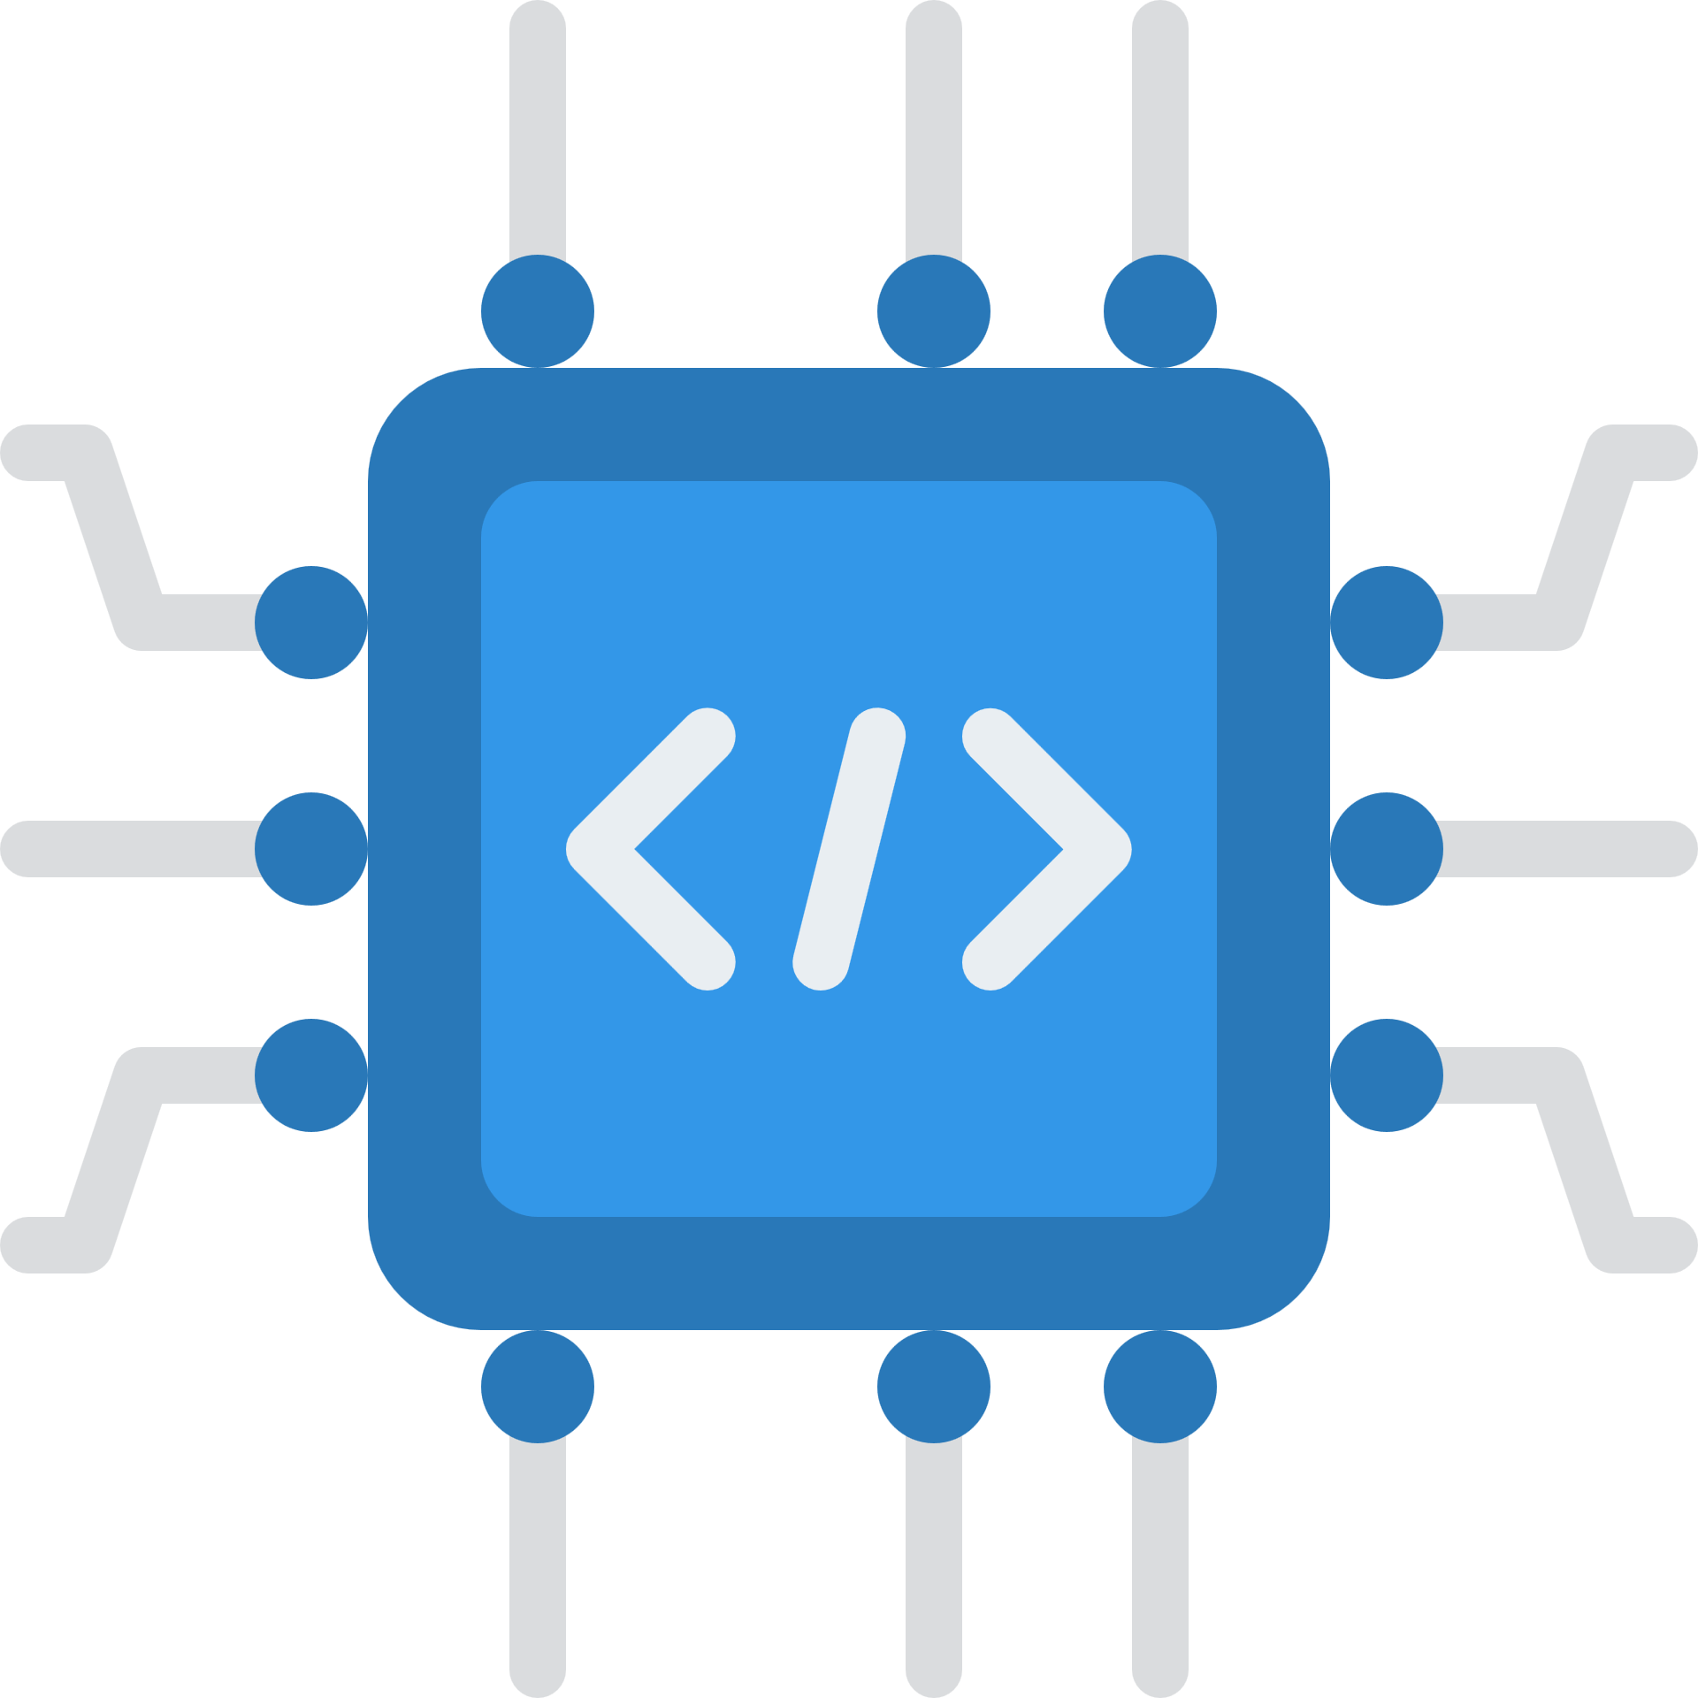
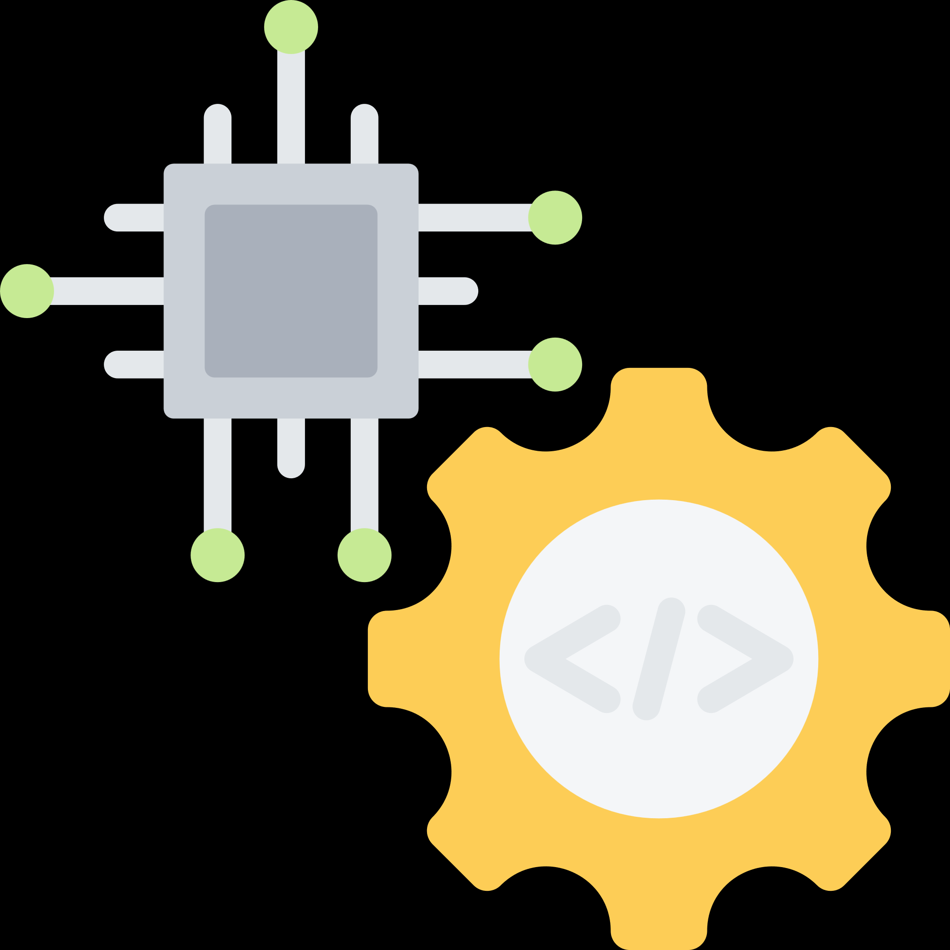
HANDS-ON EXPERENCE
CAPSTONE PROJECTS
A culminating endeavor where participants apply the knowledge and skills gained throughout The program to tackle real-world problems or create a significant deliverable, often involving research, design, and implementation

Slide 9




LET’S GET STARTED
The first step toward achieving your educational and career goals with our innovative and flexible virtual course and onsite practical.
Contact Information
+91-9840786878, 452-2330521
www.adaptit.co.in
training@adaptit.co.in

Slide 10

ADAPTIVE
INFOTECH
www.adaptit.co.in +91-9840786878

